Slide 1
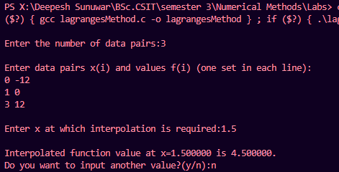
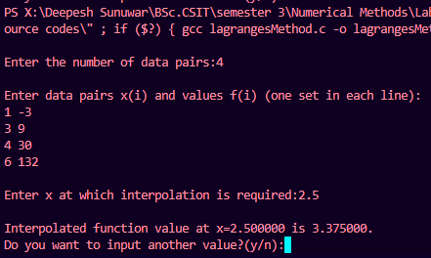
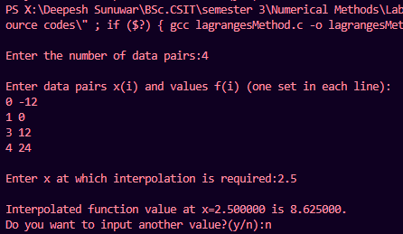
Lagrange's Interpolation method
X | 0 | 1 | 3
F | -12 | 0 | 12
1)
at 1.5
2)
X | 1 | 3 | 4 | 6
F | -3 | 9 | 30 | 132
at 2.5
3)
X | 0 | 1 | 3 | 4
F | -12 | 0 | 12 | 24
at 2.5

Slide 2
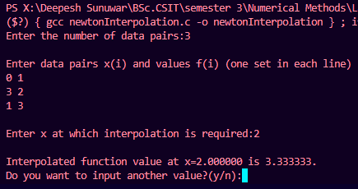
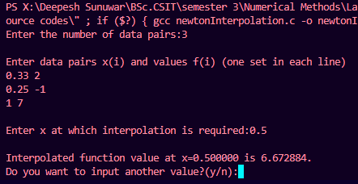
Newton’s Interpolation method
1)
x | 0 | 3 | 1
f | 1 | 2 | 3
at 2
2)
X | 1/3 | 1/4 | 1
F | 2 | -1 | 7
at 0.5

Slide 3
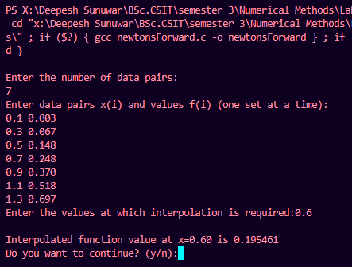
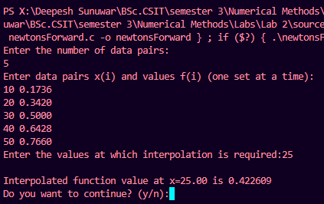
Newton’s Forward Difference method
x | 0.1 | 0.3 | 0.5 | 0.7 | 0.9 | 1.1 | 1.3
f(x) | 0.003 | 0.067 | 0.148 | 0.248 | 0.370 | 0.518 | 0.697
1)
Estimate f(0.6)
2)
θ | 10 | 20 | 30 | 40 | 50
Sinθ | 0.1736 | 0.3420 | 0.5000 | 0.6428 | 0.7660
Estimate sinƟ at Ɵ=25º

Slide 4
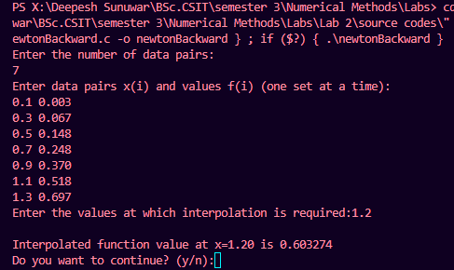
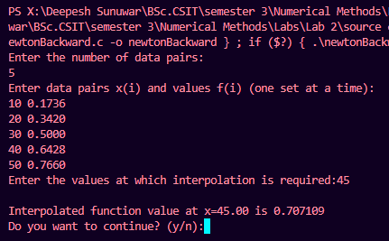
Newton’s Backward Difference method
1)
x | 0.1 | 0.3 | 0.5 | 0.7 | 0.9 | 1.1 | 1.3
f(x) | 0.003 | 0.067 | 0.148 | 0.248 | 0.370 | 0.518 | 0.697
Estimate f(1.2)
2)
θ | 10 | 20 | 30 | 40 | 50
Sinθ | 0.1736 | 0.3420 | 0.5000 | 0.6428 | 0.7660
Estimate sinƟ at Ɵ=45º

Slide 5
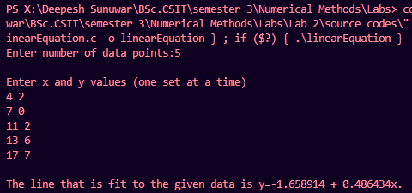
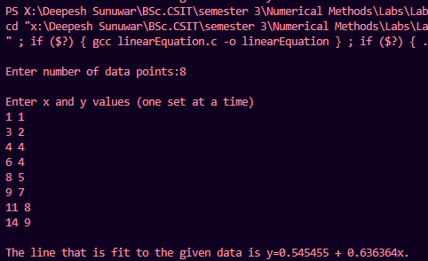
Fitting a Linear Equation
1)
x | 4 | 7 | 11 | 13 | 17
y | 2 | 0 | 2 | 6 | 7
2)
x | 1 | 3 | 4 | 6 | 8 | 9 | 11 | 14
y | 1 | 2 | 4 | 4 | 5 | 7 | 8 | 9

Slide 6
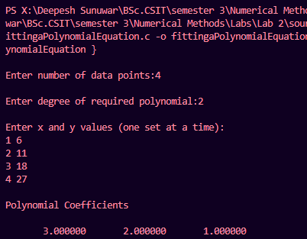
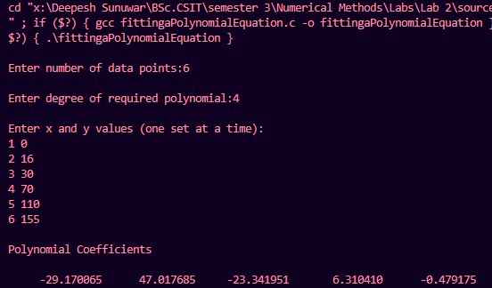
Fitting a Polynomial Equation
x | 1 | 2 | 3 | 4
y | 6 | 11 | 18 | 27
1)
Degree = 2
2)
x | 1 | 3 | 4 | 6 | 8 | 9 | 11 | 14
y | 1 | 2 | 4 | 4 | 5 | 7 | 8 | 9
Degree = 4

Slide 7
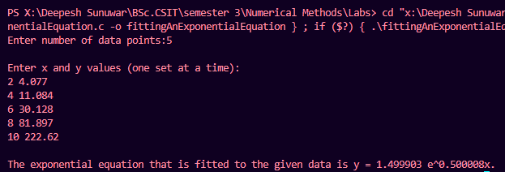
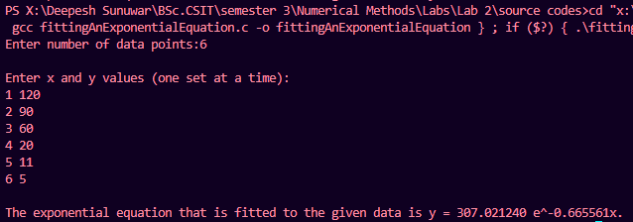
Fitting a Exponential Equation
x | 2 | 4 | 6 | 8 | 10
y | 4.077 | 11.084 | 30.128 | 81.897 | 222.62
1)
2)
x | 1 | 2 | 30 | 4 | 5 | 6
y | 120 | 90 | 60 | 20 | 11 | 5

